Slide 1
Consumer Finance Protection Bureau Complaints
Dr. Ryan Burge
July 17, 2017

Slide 2
Date Range:
January 1st, 2012 – March 21st, 2017
Total Number of Complaints:
808,618
Date Complaint Received and Date Sent to Company

Slide 3
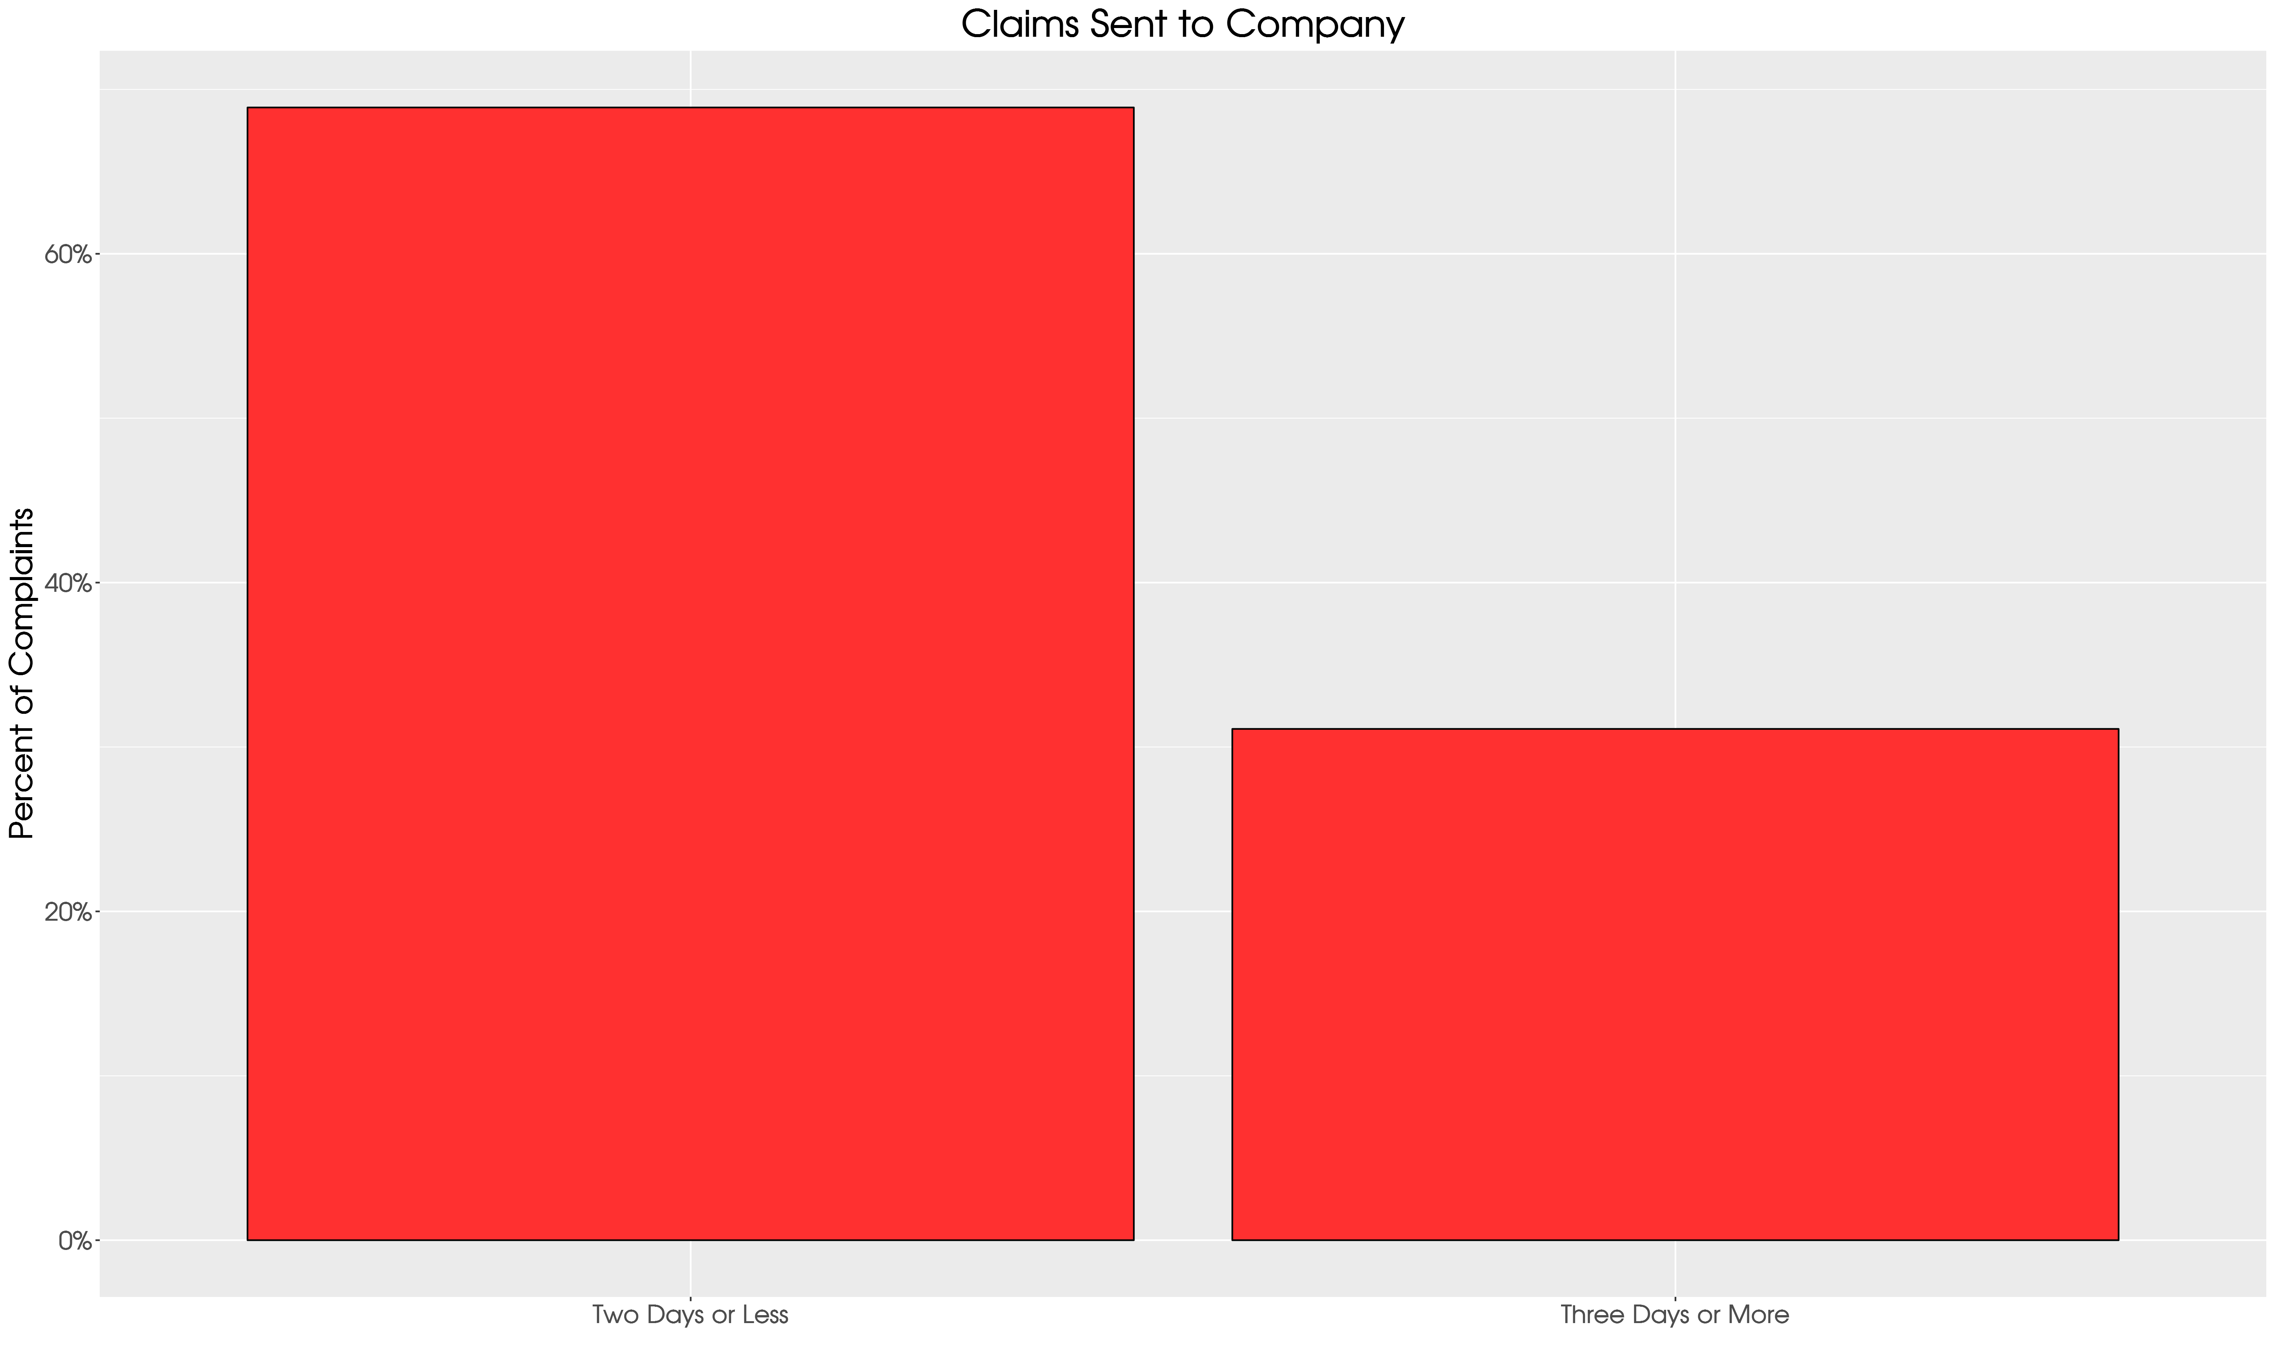
Mean Time is 4.12 days

Slide 4
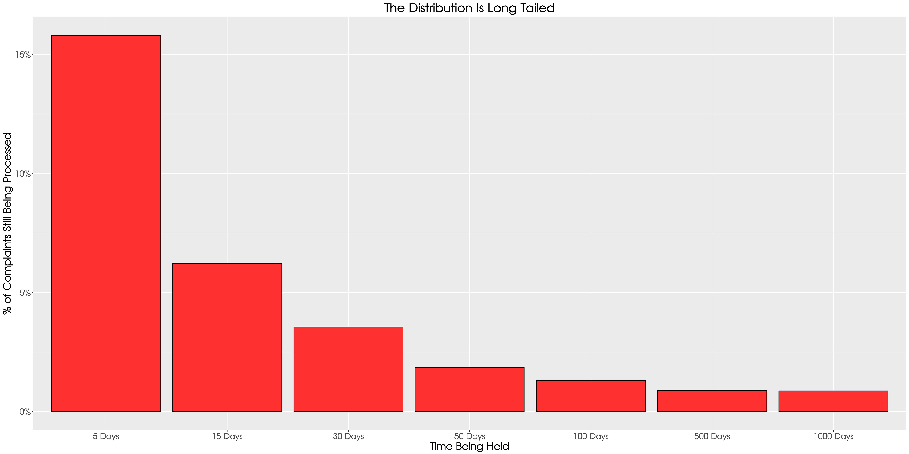

Slide 5
84% of Claims Are Being Processed in Less than 5 Days
8.5% of Claims are Held for at Least 30 days
Investigate How to Process Faster or Resolve Internally

Slide 6
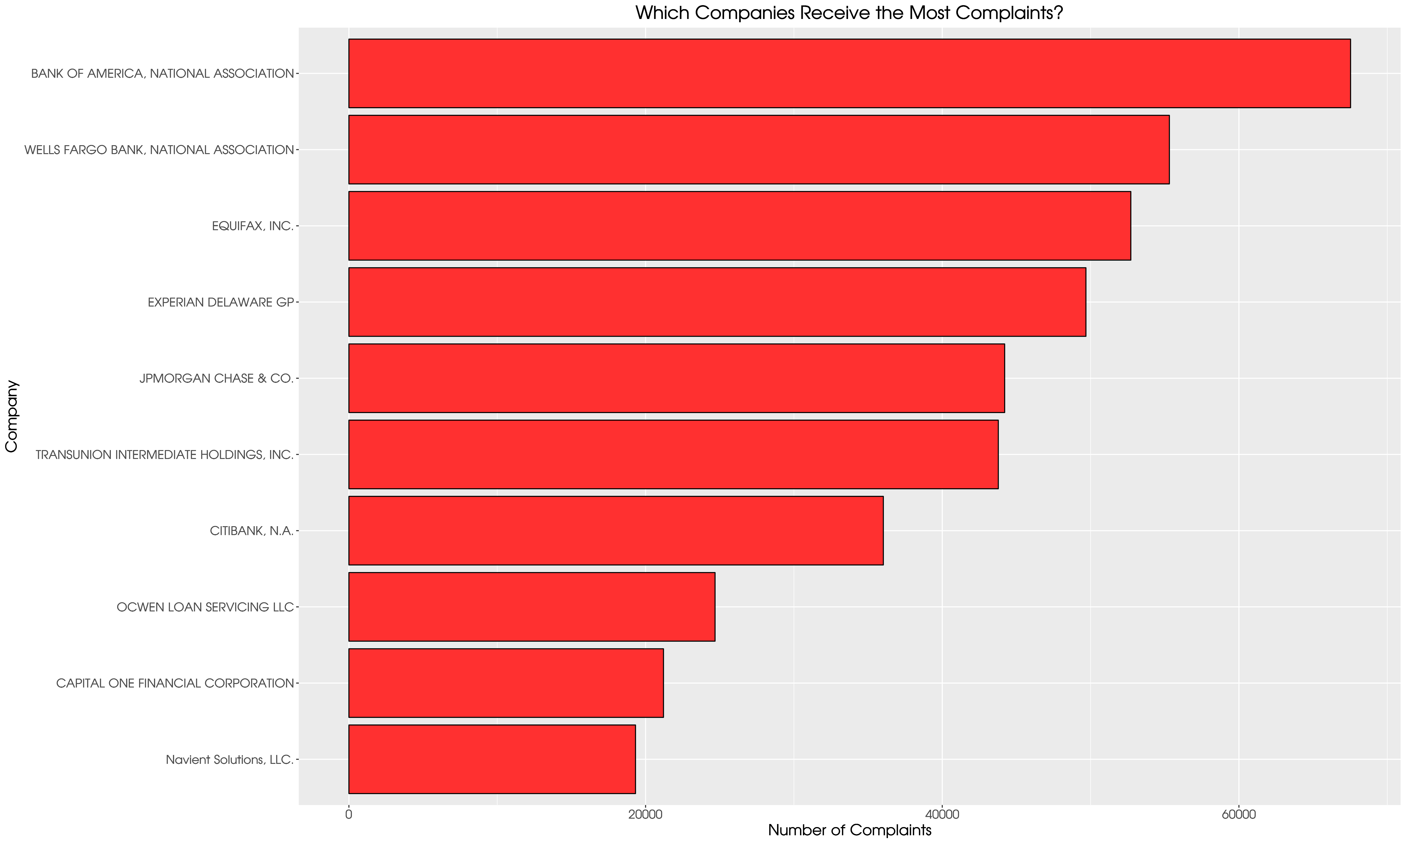

Slide 7
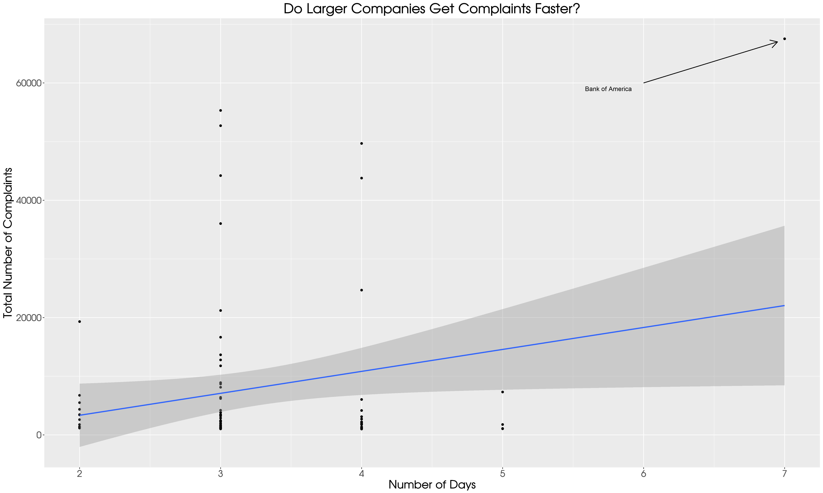

Slide 8
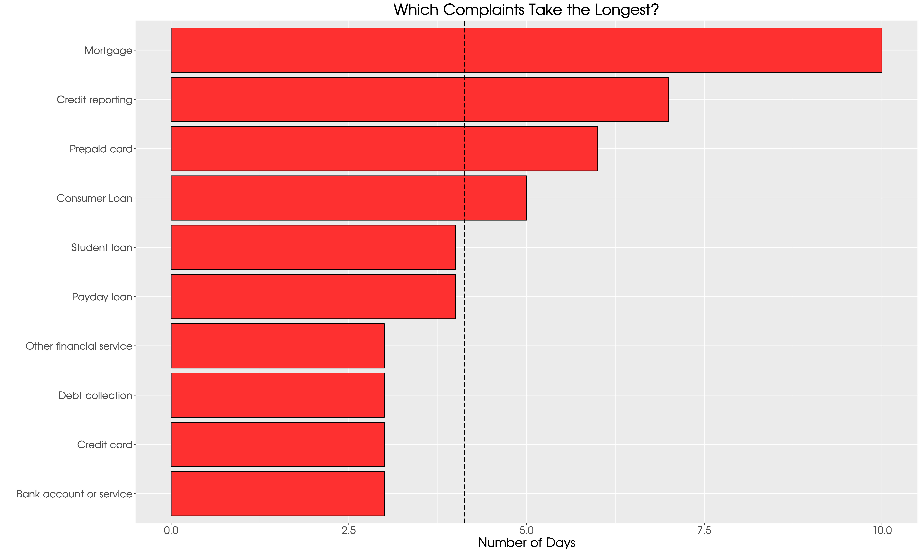

Slide 9
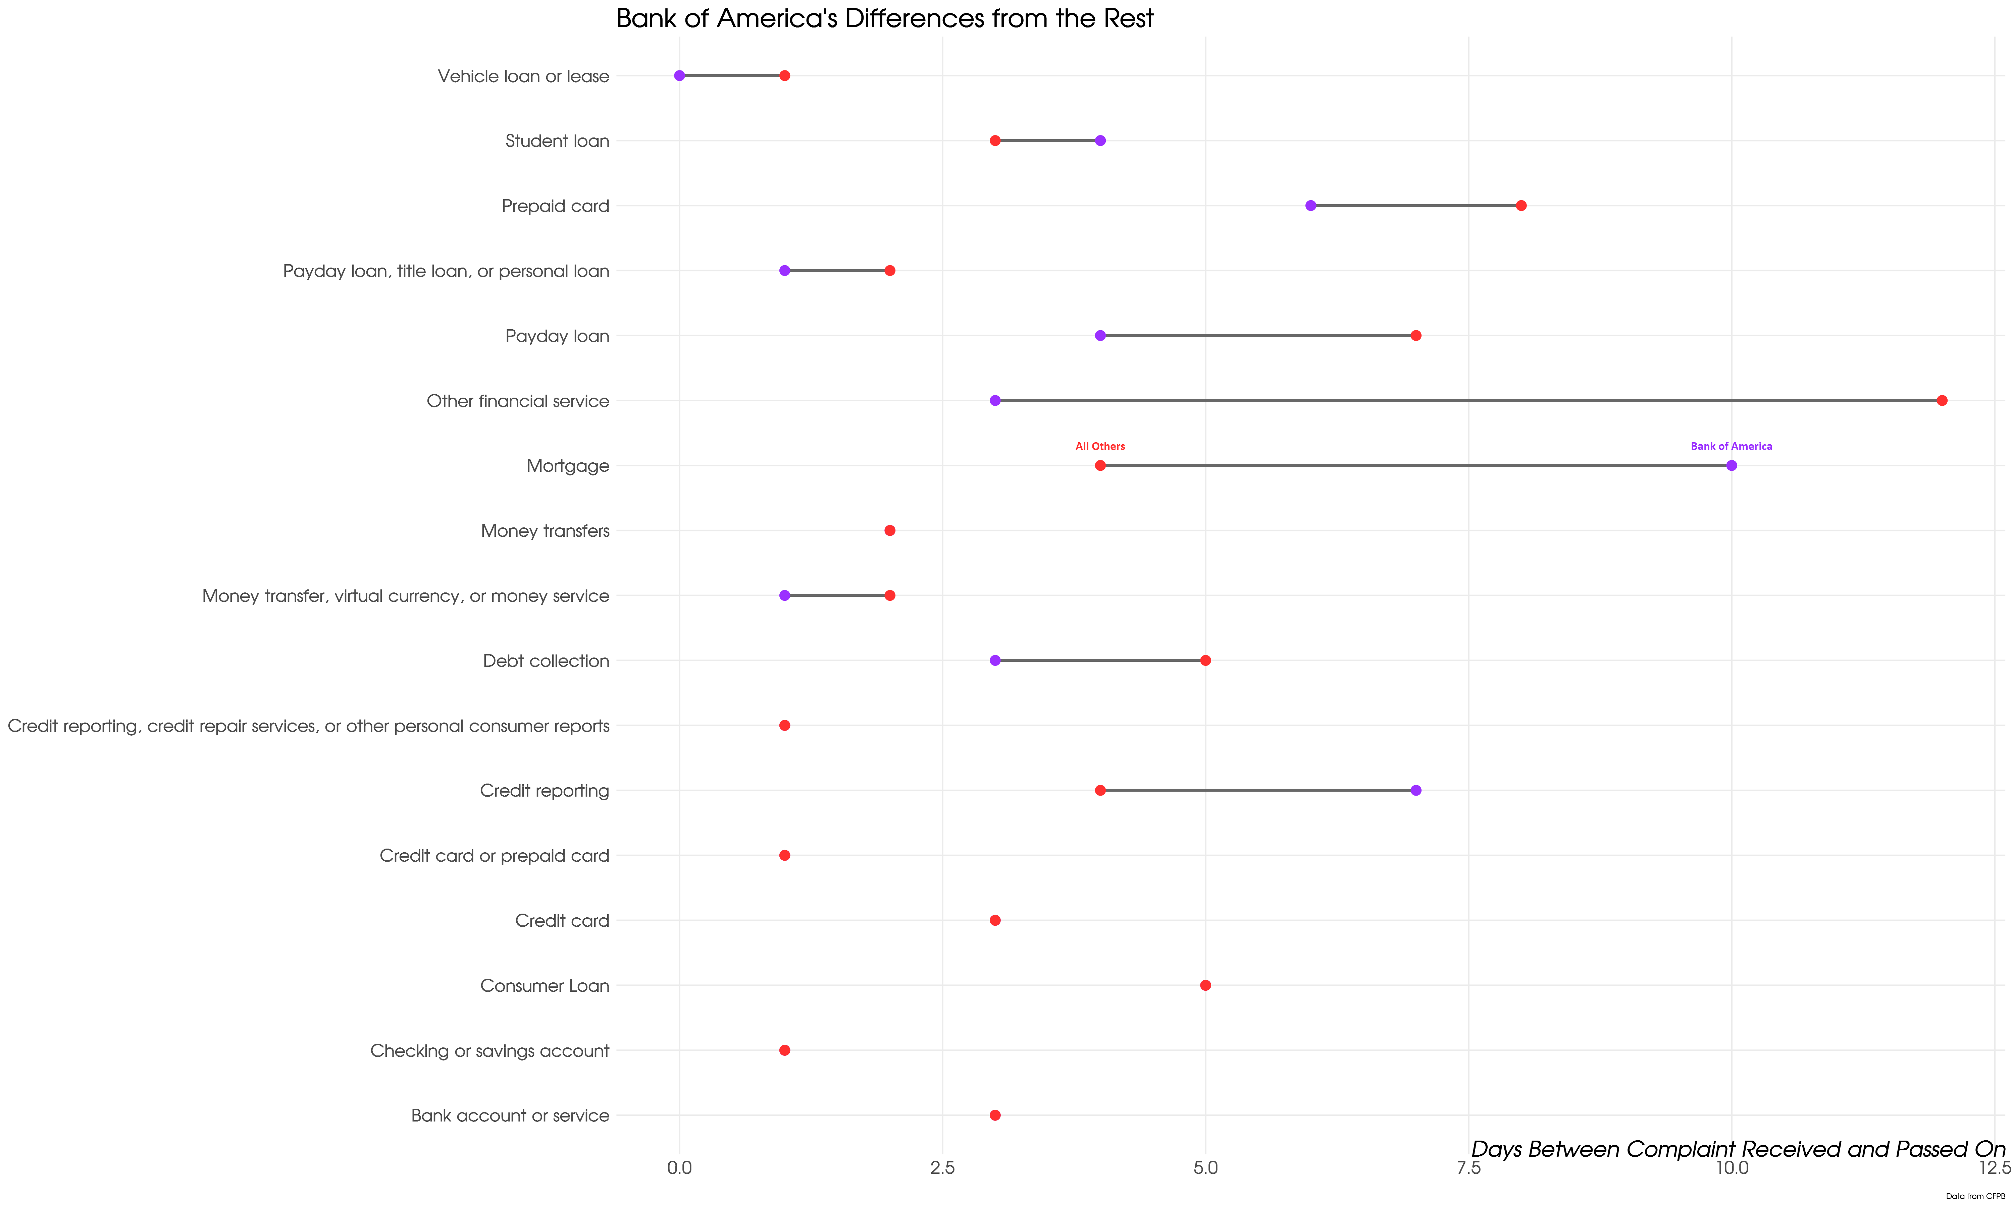

Slide 10
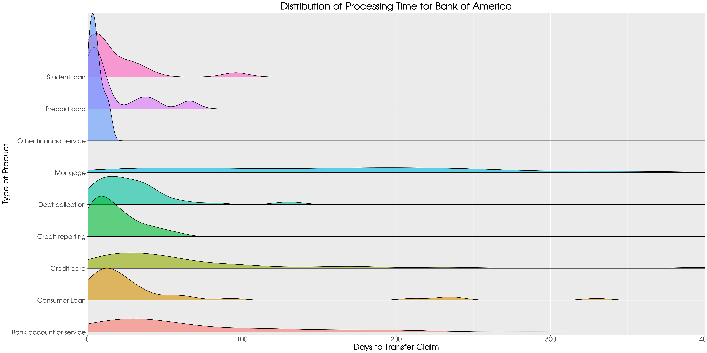
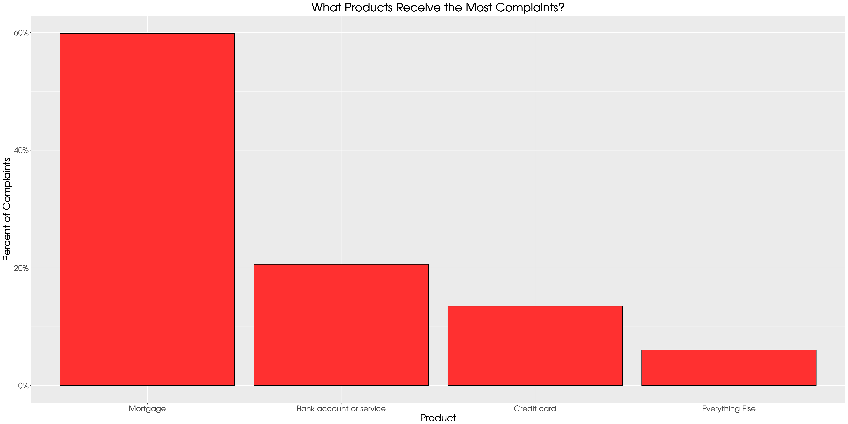

Slide 12
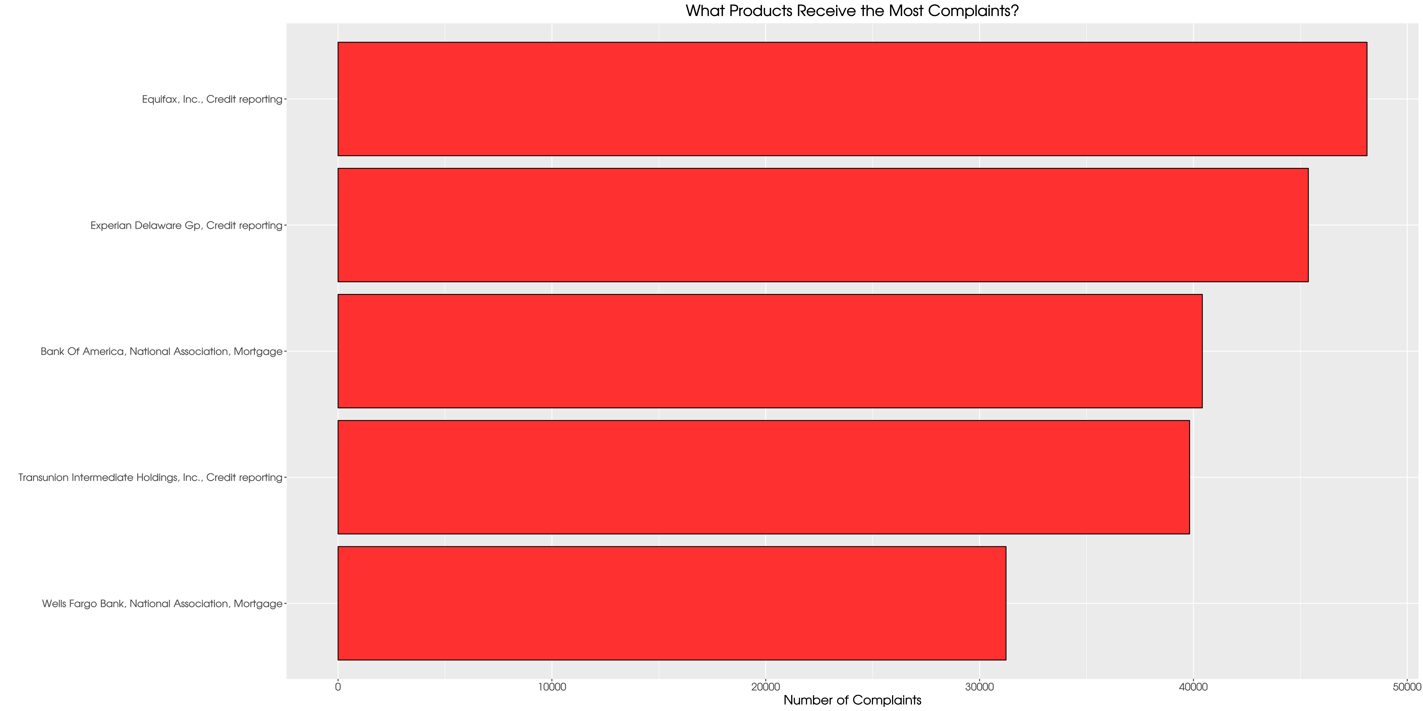

Slide 13
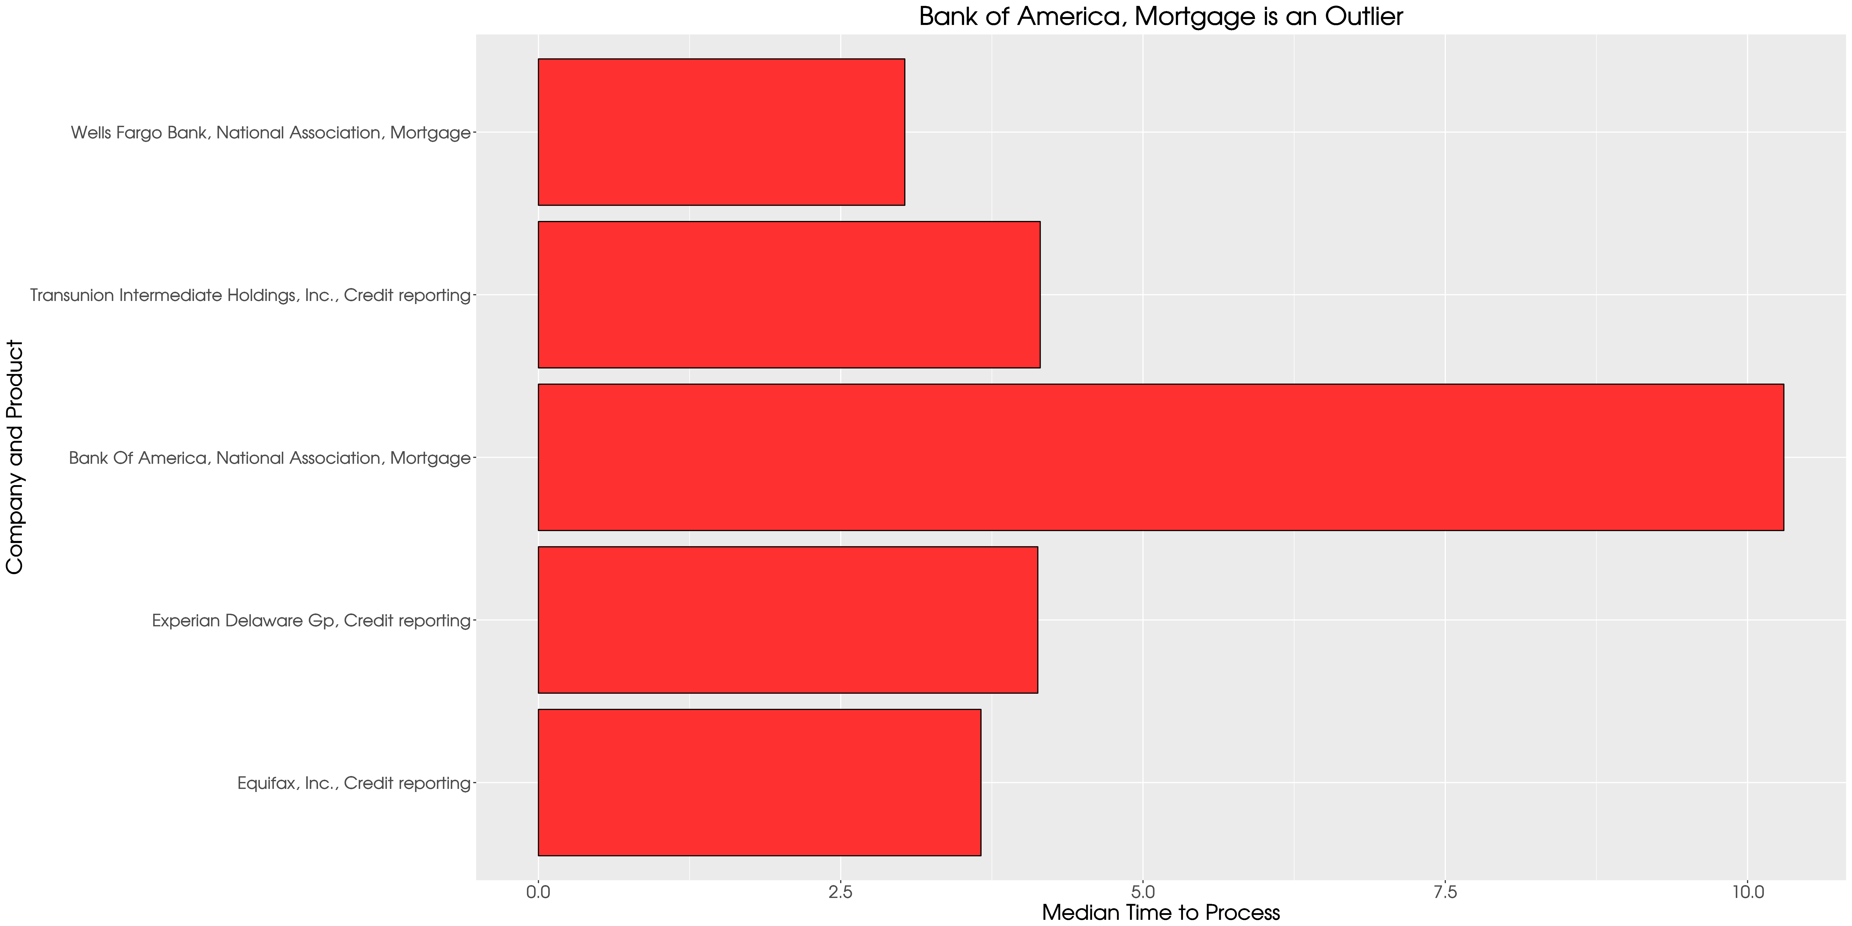

Slide 14
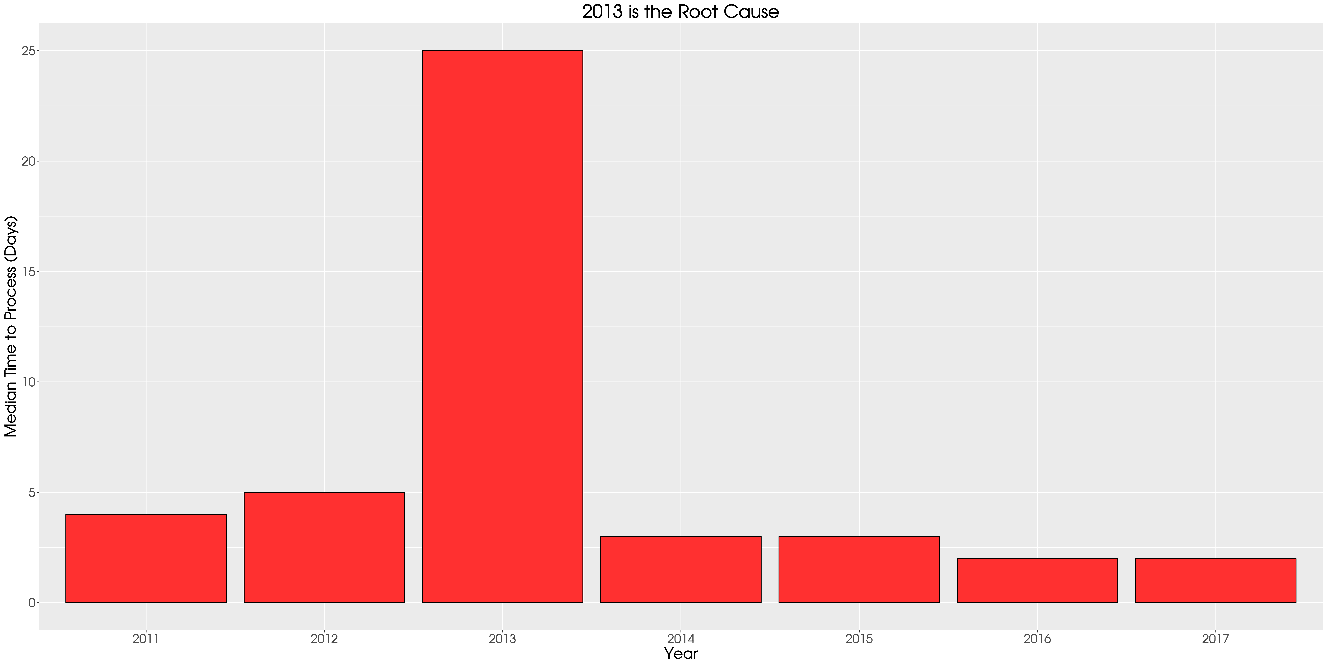

Slide 15
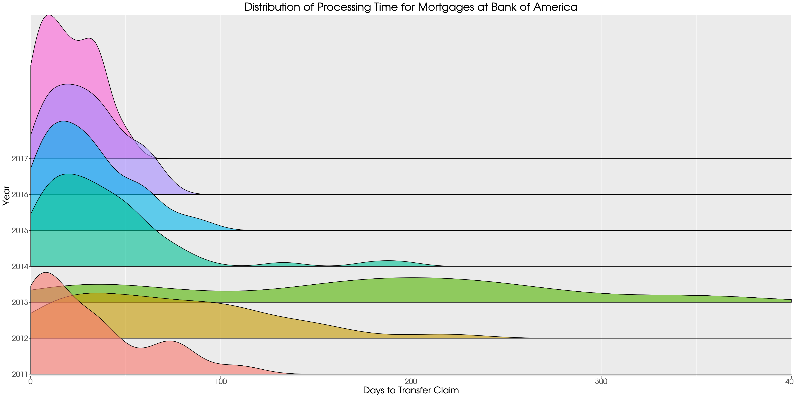

Slide 16
Bank of America Mortgage Claims are 5% of all Complaints
Case Study in Anticipating Inefficiency
Run Quarterly Reports and Flag Processing Times that Increase

Slide 17
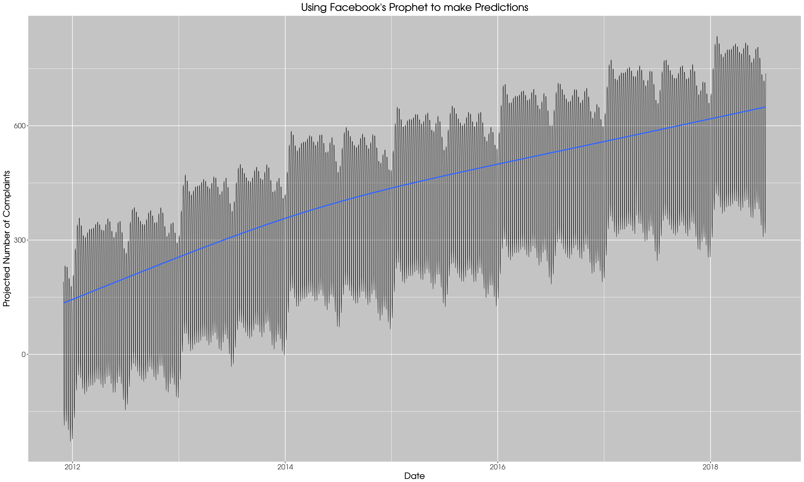

Slide 18
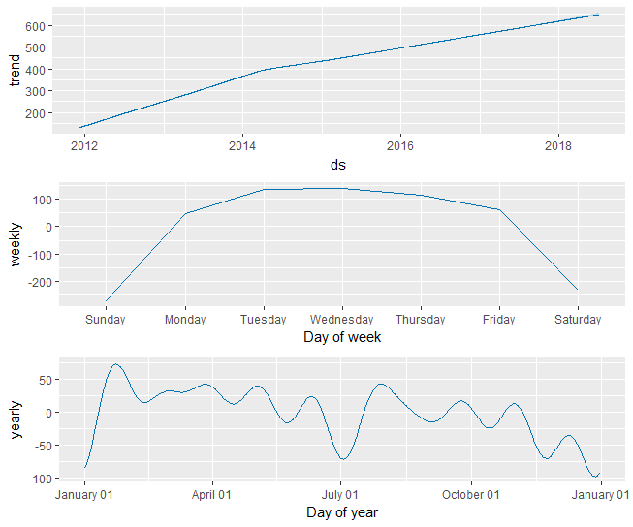

Slide 19
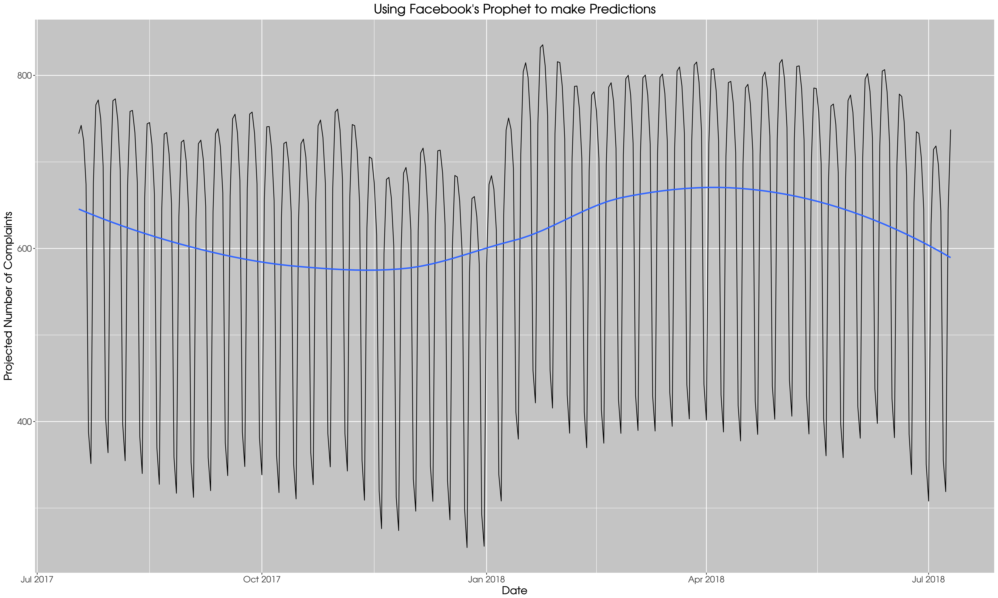

Slide 20
The trend for Complaints is A Steady Increase
7/17/17 – 7/18/17:
222,398 Claims – 609 Per Day
Busiest Day:
1/24/2018 - 835 Claims

Slide 21
Links to Prior Work
github.com/ryanburge/cfpb
Interactive Mapping with Leaflet
Shiny App with Sliders and Dropdowns
Random Forests to Identify Evangelicals
K-Means Clustering to Find Differences In Religious Traditions
Analysis of @Ump Twitter Accounts To Determine Luck

